Slide 1
Autonomous Line Follower WaiterBot
Anuja Bhide
Swapnil Kharche

Slide 2
Agenda
Introduction
WaiterBot World File
Principal Components
Future Scope

Slide 3
Introduction
WaiterBot - A line-follower robot for taking orders, serving customers and accepting payments at restaurants.
Accepts orders through the kiosk or mobile application
Serves items weighing less than 6 pounds
Notes:
The aim of this project is to design a robot for taking orders, serving customers and accepting payments at restaurants and catering venues.
It will be a line follower and will be able to travel to the target tables while avoiding obstacles such as other tables, chairs and even humans, it will use either laser scan or SONAR to detect the obstacles.
The customer will be able to call the waiterBot for placing order by using a python application interface, that would be on the table. After summoning the robot, the customer will place order verbally like ordering food in case of a human waiter.
Due to physical limitations on the payload capacity of the turtlebot, the waiterbot will only be able to serve specific items such as drinks or food items weighing less than 8 pounds.

Slide 4
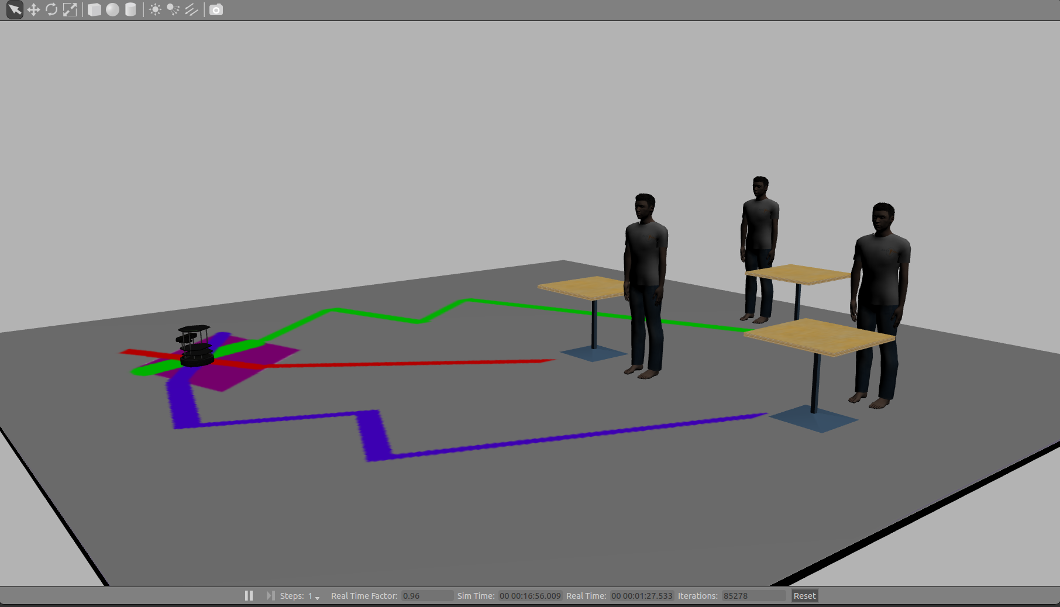
WaiterBot World File

Slide 5
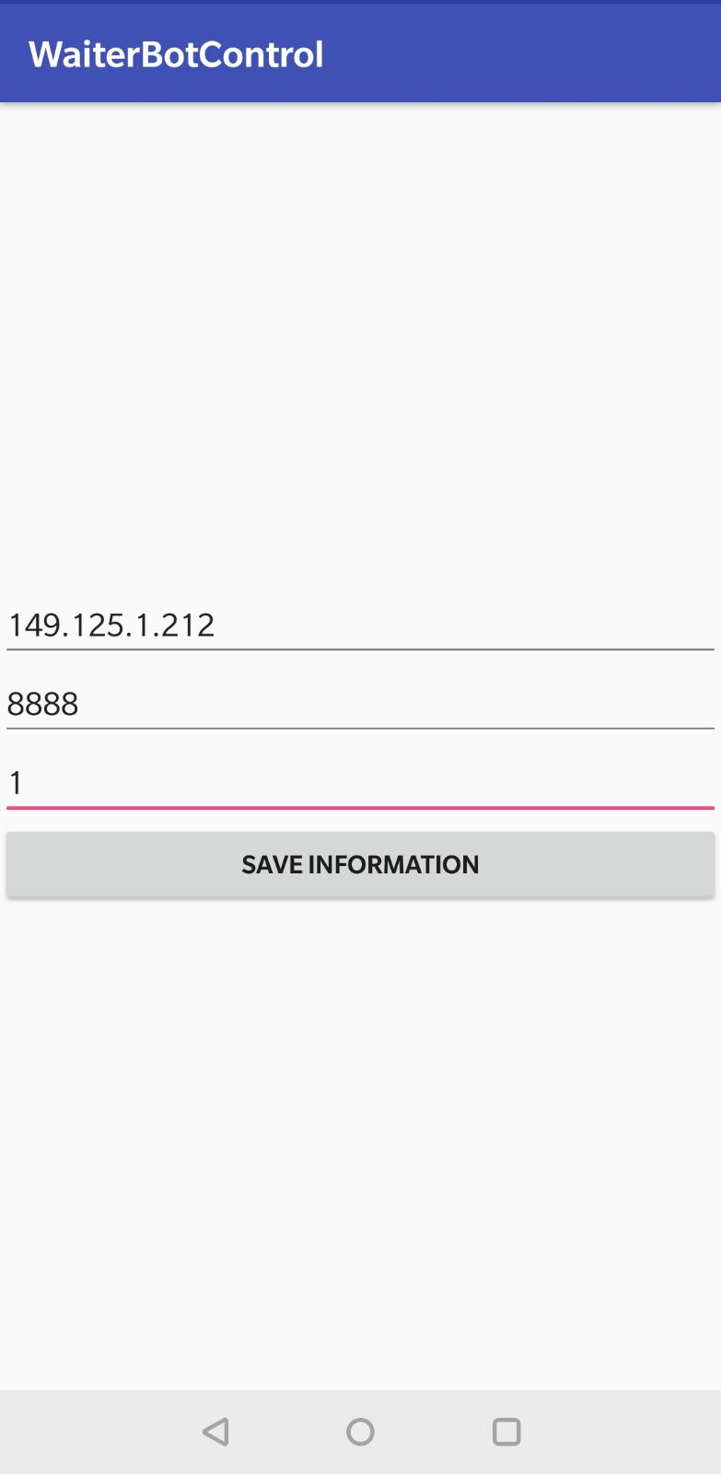
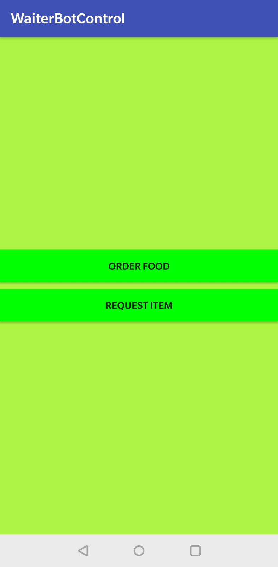
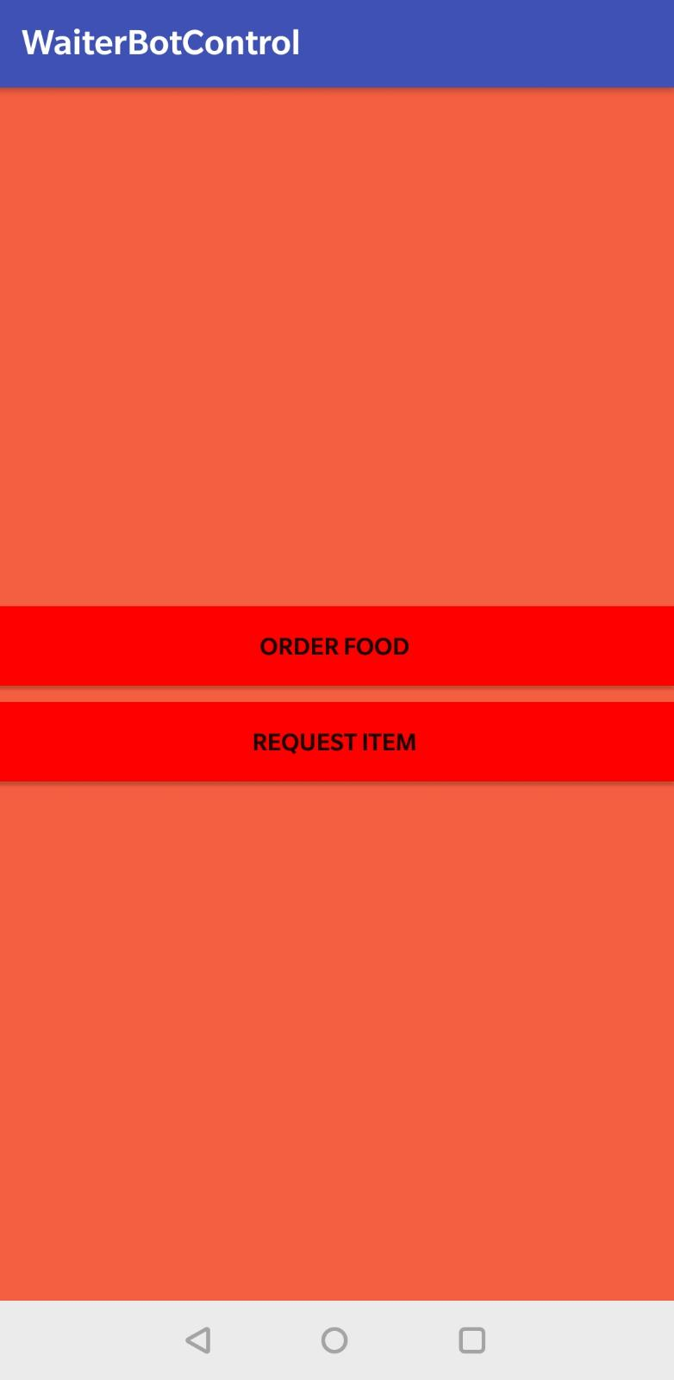
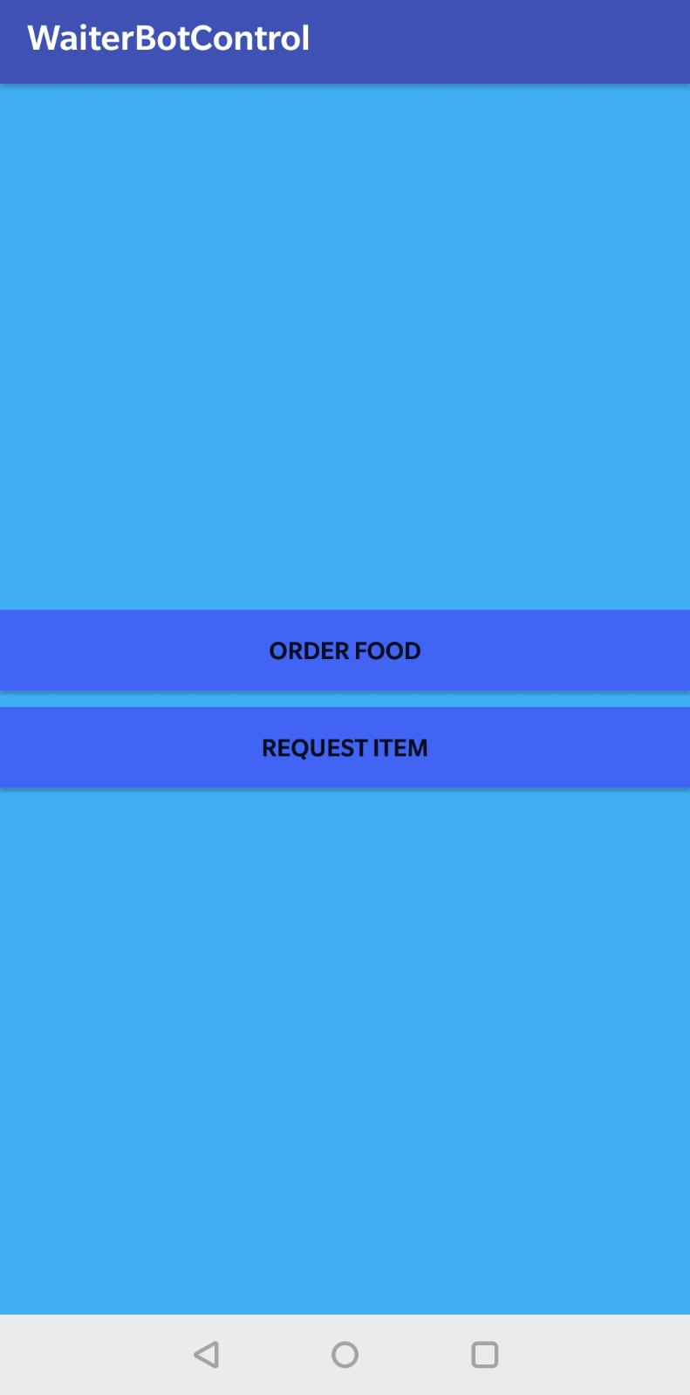
Android Application

Slide 6
Application To Control WaiterBot
Summon the WaiterBot
Send the WaiterBot back to the table
Job Scheduling (First come first serve)
Controls complete process flow
Notes:
General purpose application in python

Slide 7
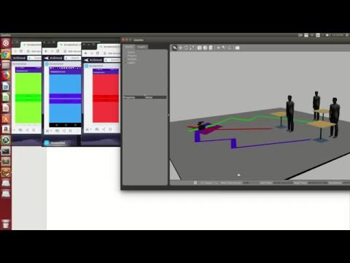
Demo

Slide 8
Principal Components
Software Interface
Line Follower
Human Interaction

Slide 9
Software Interface and Robot Voice
Software Interface:
Socket Programming
Android Client and Python Server
Can process asynchronous requests
Robot Voice
sound_play package for TTS
Play in-built sounds and OGG/WAV files
Notes:
We will be using the sound_play package as TTS system to translate commands into voice.
With this package we can play inbuilt sounds and OGG/WAV files.
The bot will be able to speak out the menu to the customers, or it faces an obstacle on the way to the customer.

Slide 10
Line Follower
Assign different colored line for every table
Adjust the camera angle
Convert the input images data from topic sensor_msgs/Image to a message format that OpenCV can process
Subscribe to topic camera/rgb/image_raw to get image data from camera
Convert image from BGR to HSV
Eliminate values that do not fall in the range to detect color
Notes:
Each table will be assigned a different color, and a there would be a colored path from the start point to the table.
We will be using the cv_bridge package to convert images coming on the topic sensor_msgs/Image to messages that OpenCV can open and display.
We would need to subscribe to the topic camera/rgb/image_raw to get the data from the camera.
We would need to convert the image from BGR to HSV using the cv2 library, define the lower and upper limits of the color degrees, and remove all the other elements that don’t fall in the range, to detect the color.
We would need to set the camera angle accordingly, say at a distance of 1 meter to point to the exact center of the line.

Slide 11
Future Scope
Multi-bot system
Gesture recognition
Integration with robotic arm

Slide 12
Thank You!

